Slide 1
Hull-White model

Slide 2
Agenda
Fundamentals
Short rate models
Vasicek model
Hull-White model
Two-factor Hull-White model

Slide 3
Fundamentals
Money-market account (cash-account)
Value of the money-market account at time t is B(t) and B(0)=1. It evolves according to:
where r(t) is called instantaneous rate/instantaneous spot rate/ short rate.
Since the differential equation doesn’t contain random factor it is described as risk-free
(even though r(t) could be stochastic).
Discount factor D(t,T)

Slide 4
Fundamentals
Zero-coupon bond
A T-maturity zero-coupon bond (pure discount bond) is a contract that quarantees its holder the
payment of one unit at time T. Contract value at time T is denoted by P(t,T). Of course P(T,T)=1.
If the short rate is deterministic then for s<t<T
and
Empirical evidence suggests that
and
Hence, short rate is stochastic!

Slide 5
Fundamentals
Continuously-compunded spot interest rate
The continuously-compounded spot interest rate prevailing at time t for the maturity T is denoted
by R(t, T) and is the constant rate at which an investment of P(t, T) units of currency at time t
accrues continuously to yield a unit amount of currency at maturity T:
or equivalently
Simply-compounded spot interest rate (when accruing is proportional to the time of the investment)
The simply-compounded spot interest rate prevailing at time t for the maturity T is denoted by L(t, T)
and is the constant rate at which an investment has to be made to produce an amount of one unit
of currency at maturity, starting from P(t, T) units of currency at time t, when accruing occurs
proportionally to the investment time.

Slide 6
Fundamentals
Simply-compounded forward interest rate
The simply-compounded forward interest rate prevailing at time t for the expiry T > t and maturity
S > T is denoted by F(t; T,S) and is defined by
In other words we are fixing the rate of interest between times T and S in advance at time t.
Continuously-compounded forward interest rate

Slide 7
Fundamentals
Instantaneous forward interest rate
The instantaneous forward interest rate prevailing at time t for the maturity T > t is
denoted by f(t, T) and is defined as
Interesting identities

Slide 8
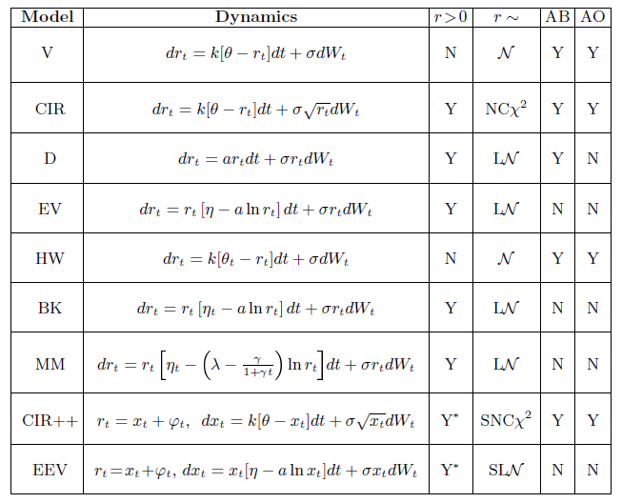
Short rate models
Examples

Slide 9
Short rate models
Vasicek model (risk-adjusted measure; mean-reverting proces)
all of constants are positive
Solution.
Let’s substitute
then
finally

Slide 10
Short rate models
Vasicek model - properties
expected value
variance

Slide 11
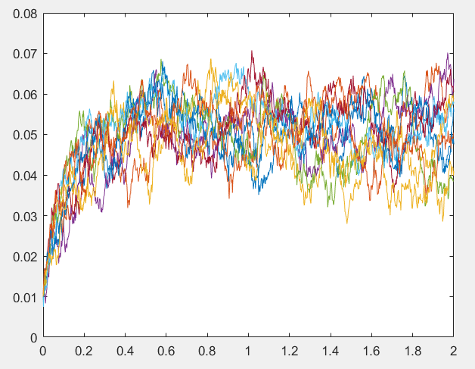
Short rate models
Vasicek model - properties
probability distribution function
asymptotic properties

Slide 12
Short rate models
Vasicek model - pricing
formula (affine term-structure: drift and variance must be affine)
where
Question:
What is the limiting price of zero_coupon bond when T->+Inf?

Slide 13
Short rate models
Vasicek model - pricing
The price at time t of a European option with strike X, maturity T and written on a pure discount
bond maturing at time S has been derived by Jamshidian (1989).
where
and

Slide 14
Short rate models
Vasicek model - identities
instantaneous forward rate
Question:
What is the limiting value of f(t,T) when T tends towards t?
Prove that for affine term-structure (in general) the following formula holds

Slide 15
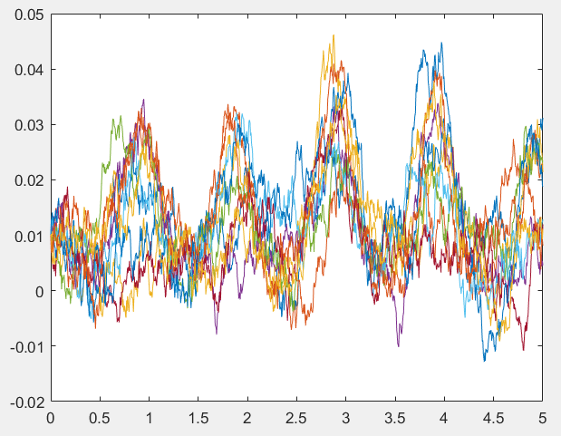
Short rate models
Hull-White model
dynamics given by
or
We focus on a special case
Solution (again gaussian)

Slide 16
Short rate models
Hull-White model – properties
different form of the solution
where

Slide 17
Short rate models
Hull-White model – properties
Let’s introduce stochastic process
hence
One-factor gaussian model!

Slide 18
Short rate models
Hull-White model – pricing
where
hence
where

Slide 19
Short rate models
Hull-White model – pricing
Option prices
where

Slide 20
Short rate models
One-factor affine models main drawback
We know that
hence
Let’s find correlation
possible solution -> two-factor models

Slide 21
Short rate models
Two-factor additive model
We know that one-factor gaussian model (one-factor Hull-White) has a form
where
Simple generalization: two-factor Hull-White model
where
then

Slide 22
Short rate models
Two-factor Hull-White model
solution (gaussian)

Slide 23
Short rate models
Two-factor Hull-White model - pricing

Slide 24
Short rate models
Two-factor Hull-White model - pricing
We don’t have to differentiate the interest rate curve!

Slide 25
Short rate models
Two-factor Hull-White model – equivalent formulation
where

Slide 26
Thank you for your attention

